Slide 1
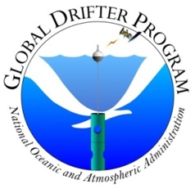
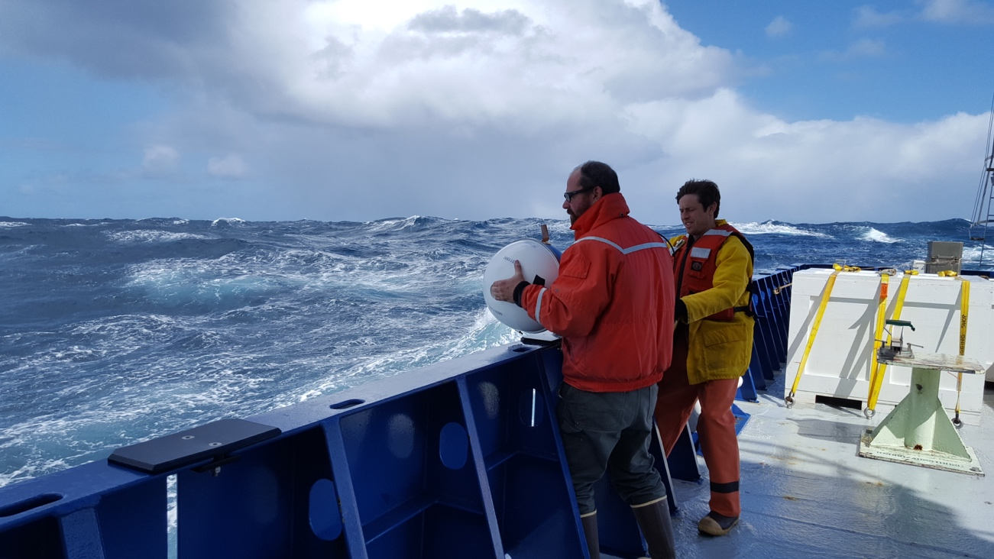
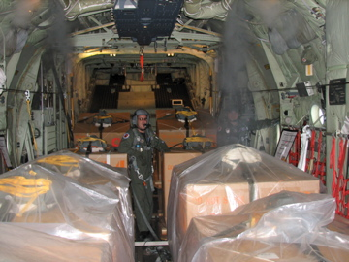

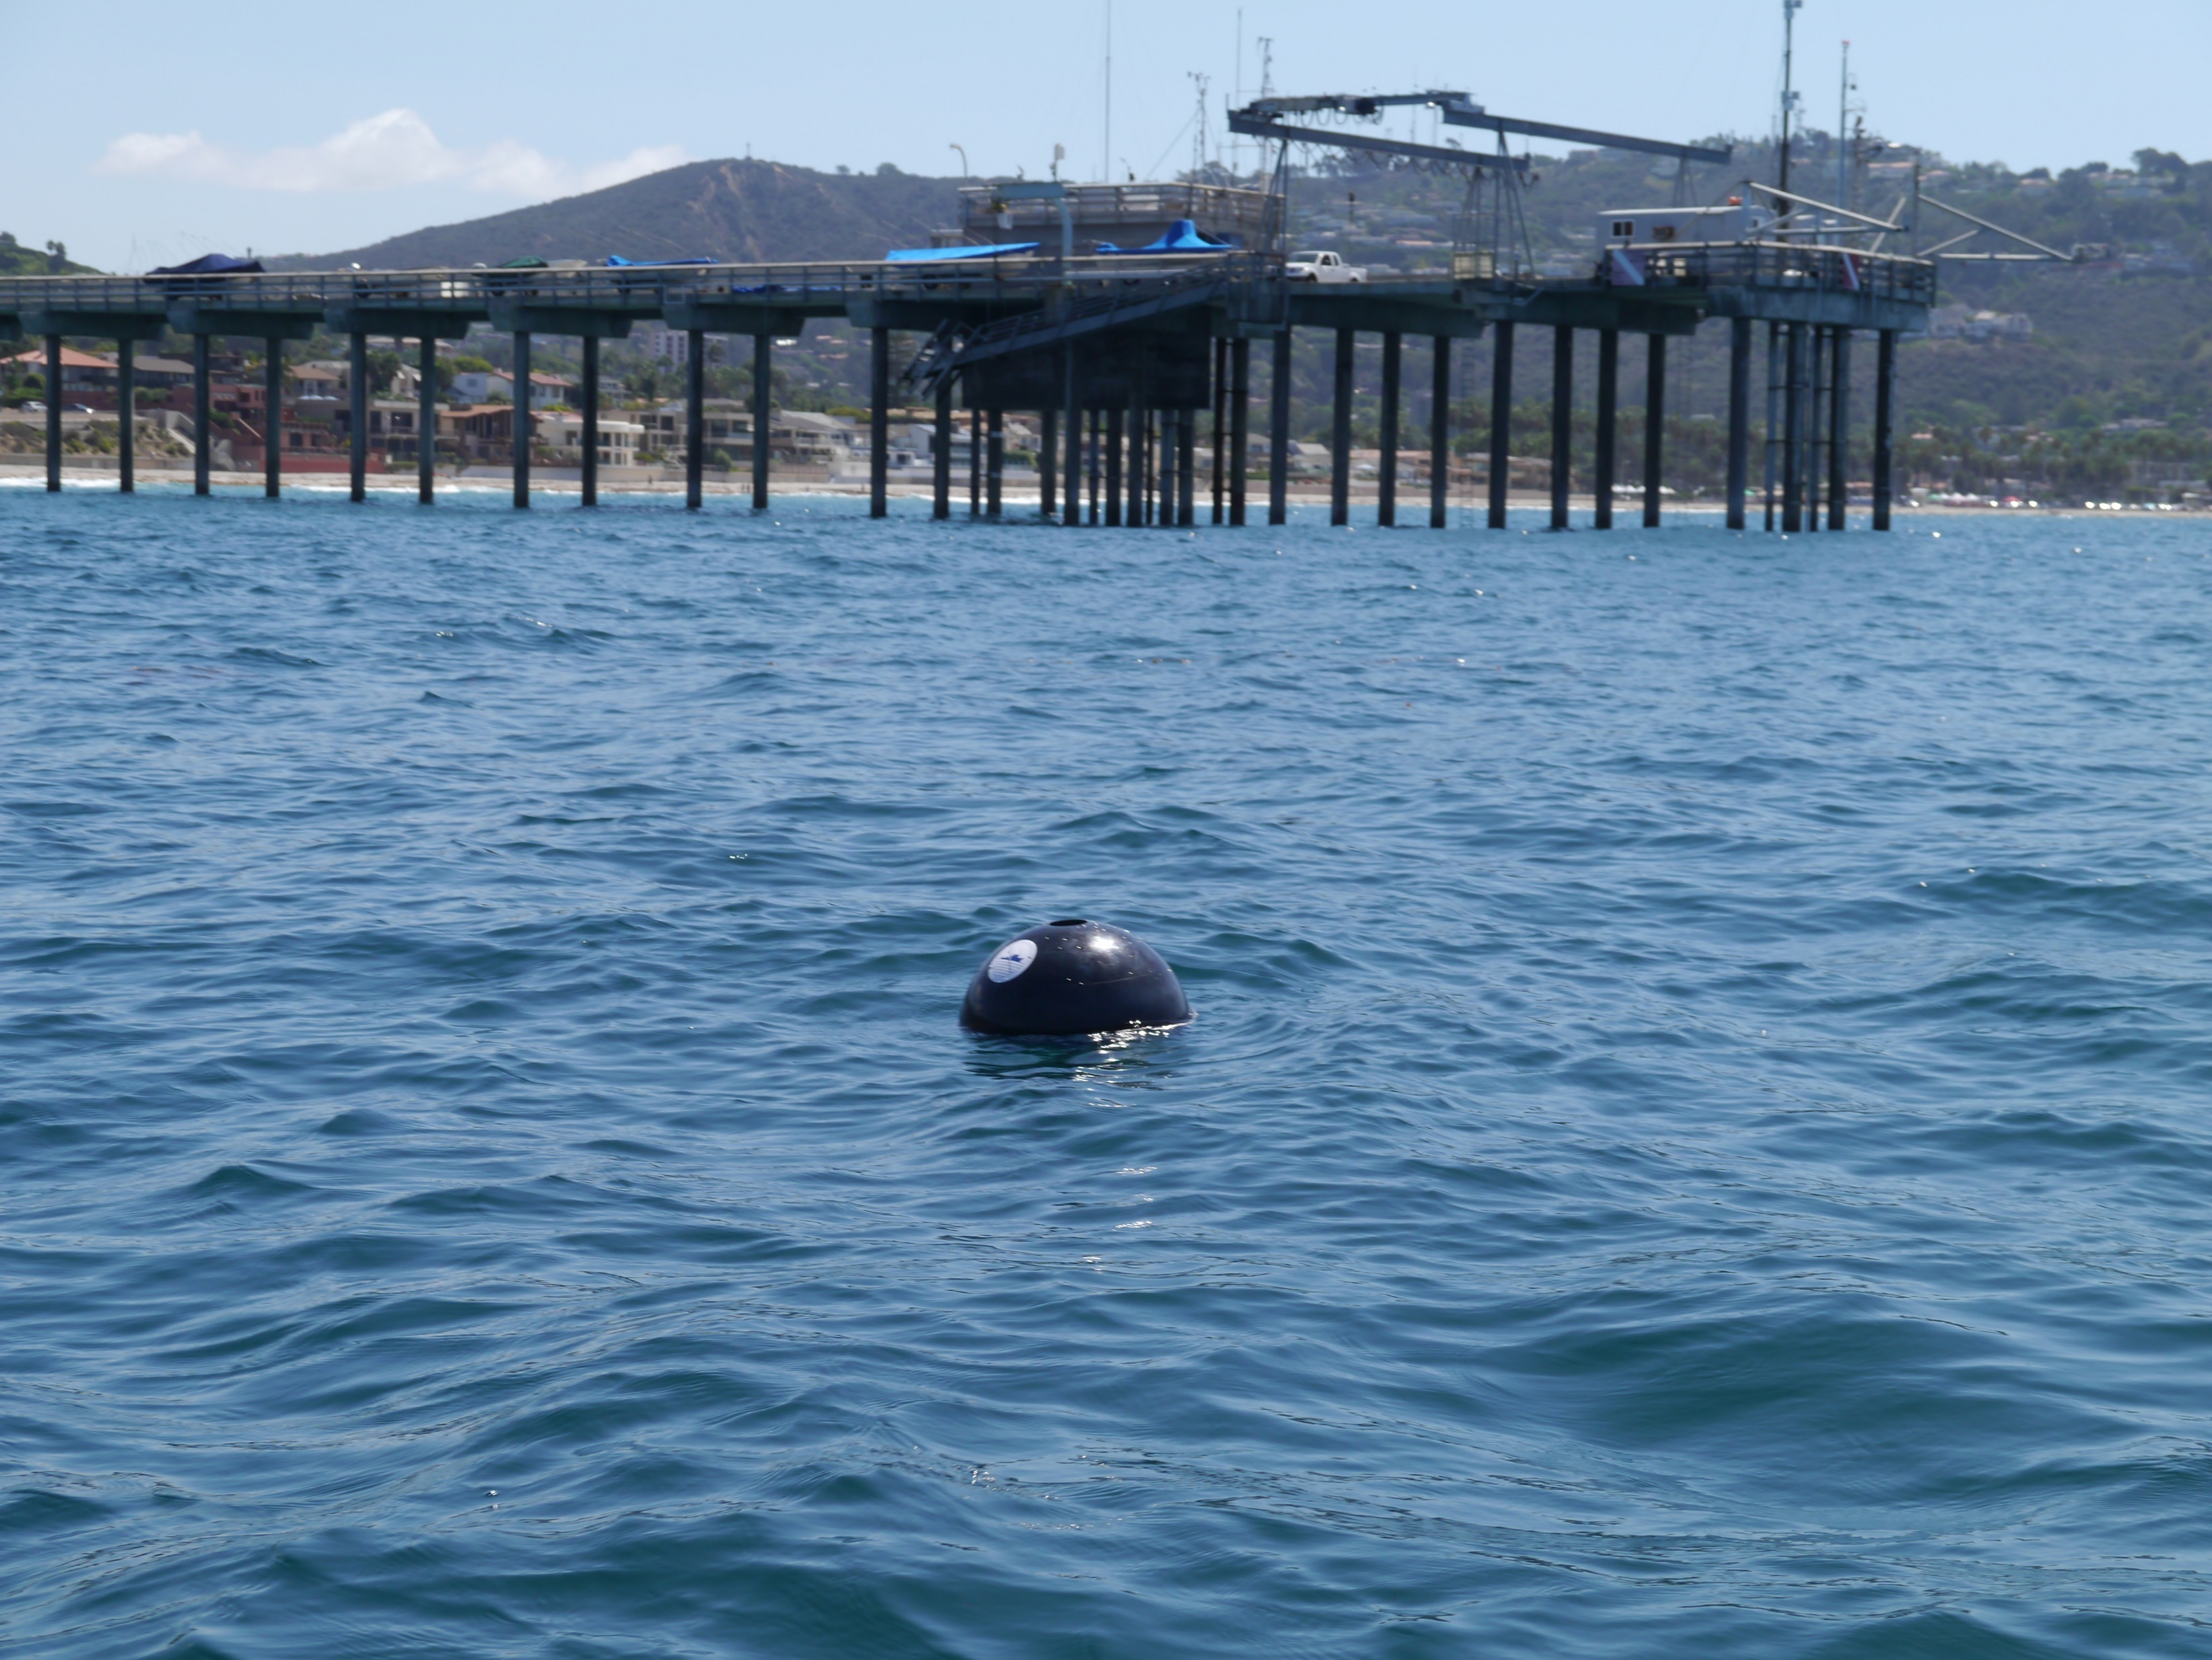
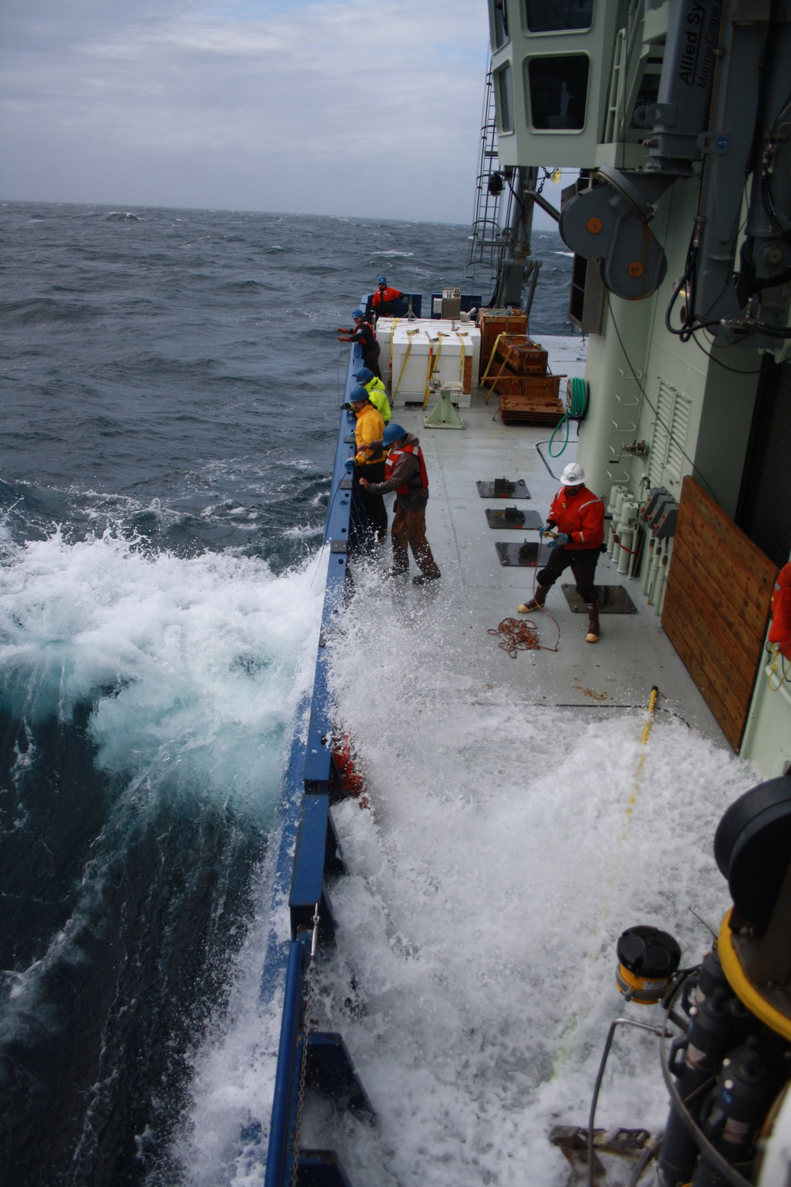

Observations of Waves from Drifters: Technology and Vision for a Sustainable Global In-Situ Array
Luca Centurioni
Director, Lagrangian Drifter Laboratory
And Global Drifter Program
Cooperative Institute for Marine Ecosystems and Climate (CIMEC)
Climate, Atmospheric Sciences, and Physical Oceanography
Scripps Institution of Oceanography
La Jolla, California, USA
lcenturioni@ucsd.edu, http://gdp.ucsd.edu/
Sea State Climate Change Initiative (CCI),User Consultation Meeting 2019, October 8-9 2019, Brest, France

Slide 2

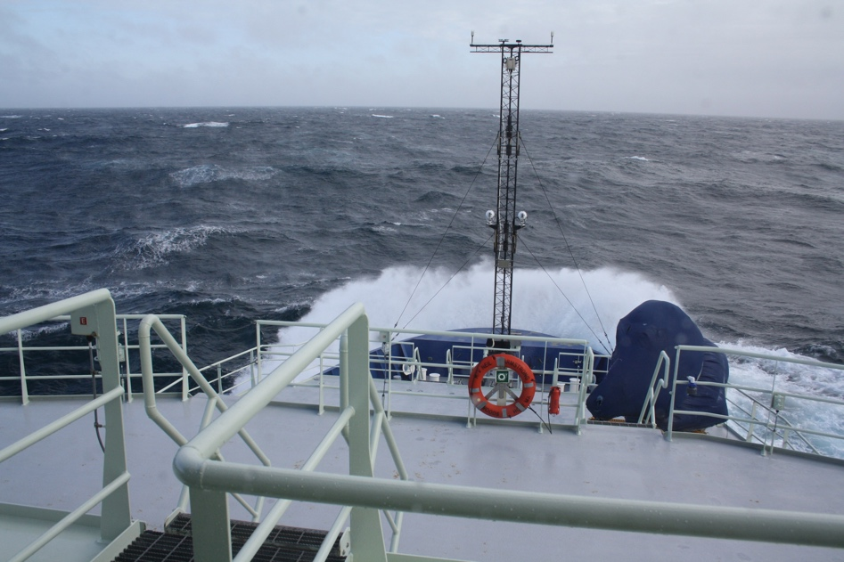
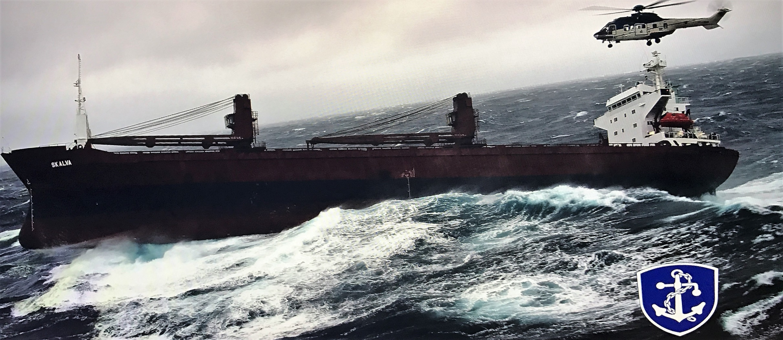
Motivations for in-situ
Open Ocean Wave Observations
Validation and forecasting: Real-time validation of wave forecasting products, assimilation of wave data into wave forecasting models, open ocean in-situ Boundary conditions to improve coastal wave forecasts where people live and work
Societal: Navigation efficiency and safety (wave/Gulf Stream interactions), SOLAS, marine insurers, Lloyd's ship hull strength metric, wave inundation warnings (e.g. India, Sri Lanka, West Africa)
Science: Wave propagation (trans-basin/local), air-sea interaction (e.g. momentum and gas fluxes), wave/current interaction (e.g. wave modulation by strong currents), wave/wave interaction, wave/internal wave interaction (implications for diapycnal mixing), engineering of offshore structures, climate assessment, risk assessment and planning
Satellite missions: Calibration and validation of remotely sensed significant wave height and spectral characteristics retrievals of the surface wave field
Photo credit: Icelandic Coast Guard
Waves and their interaction with currents have caused serious ship accidents. In-situ data are needed to constrain/validate models and notify mariners of hazardous conditions
In-situ wave observations in the open ocean are very sparse.
Outer-shelf, inner-shelf and the coastal wave measuring installations combined outnumber the offshore installations by a 4:1 ratio.
An open ocean network of wave sensors is virtually non-existent

Slide 3
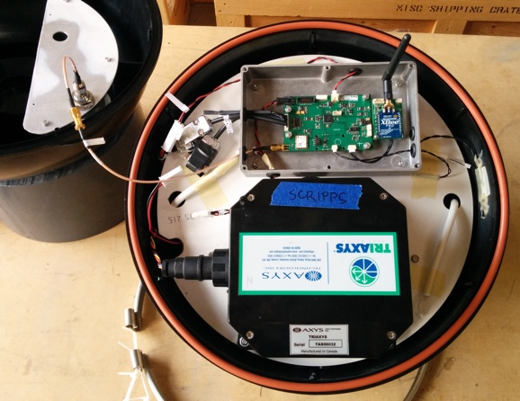
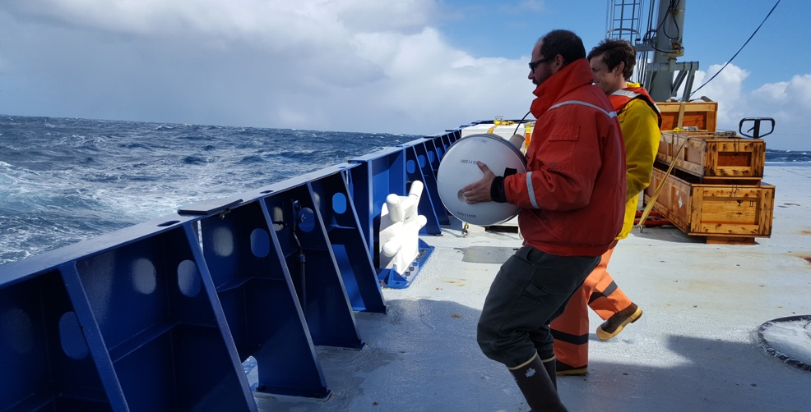
The Path to Measuring Directional Surface Gravity Waves Globally from Expendable Drifters
CONCEPT
GPS based wave sensors, have been around for a long time (e.g. Krogstad et al. 1999). The GDP solution presented here, called DWSD, is very cost effective, ~$1/observation.
Main Characteristics are:
accurate, real-time, calibration-free
Low power and cost, small size and weight
Full spectra
Open data, no ownership clauses
Integrated into the GDP data/metadata system and GTS ready
Developed at the LDL/SIO, but within the international framework. Specifically, in collaboration with the WMO and JCOMM sponsored Task Team on Wave Measurements of the DBCP to ensure needs of the greater community are met and addressed
Top Validation: Triaxys Wave sensor co-located in DWS hull.
Bottom LDL Drifter deployment by Ben Kates in the North Atlantic, May 2018
Definitions
Directional Wave Spectra Drifter (DWSD)
Data Buoy Cooperation Panel (DBCP)
Joint Technical Commission for Oceanography and Marine Meteorology (JCOMM)
World Meteorological Organization (WMO)
Global Telecommunication System (GTS)

Slide 4
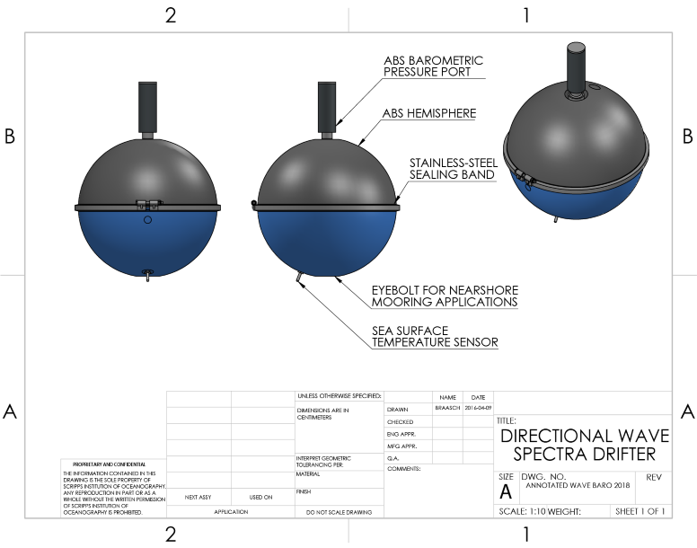
The Directional Wave Spectra Barometer (Option) Drifter (DWS-B-D)
THE LDL DWS-B Drifter
DESIGNED TO MEASURE DIRECTIONAL SURFACE GRAVITY WAVES
Technical Specifications
Construction:
Same components and hardware construction as the SVPB family instrument
Extension of existing platform => SVPB drifter with less hardware but more software
Sensors:
GPS localization (accuracy: 10 m rms)
SST (thermistor ±0.05° C, @ ~17cm depth)
SLP (Honeywell IPT, ±0.4hPa ) - optional
Directional Wave Sensor (GPS based, 2sec-32sec wave periods; Frequency spectrum a₀ , a₁, b₁, a₂, b₂ and Integral parameters H_{m0}, T_{p}, T_{a}, D_{d}
Telemetry:
2-way Iridium telemetry for fast data relay (< 1 min) and over-the-air mission control
Damping chain element not shown
CAN BE MOORED OR FREELY DRIFTING
DWS drifter deployments began in 2015. Since inception, over 100 DWS drifters have been deployed globally

Slide 5
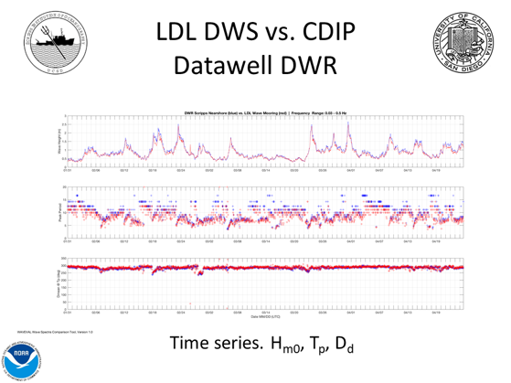
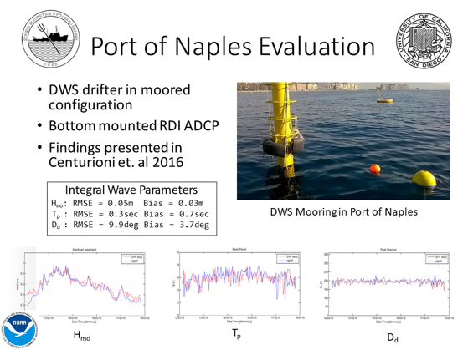
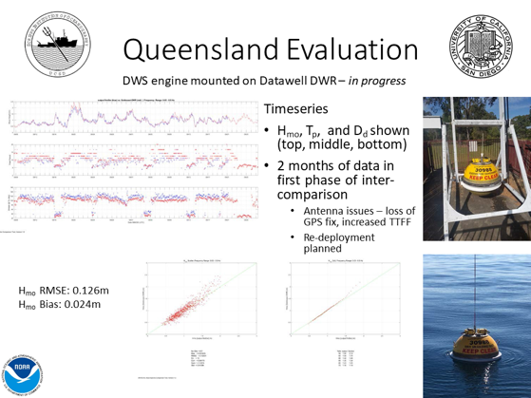
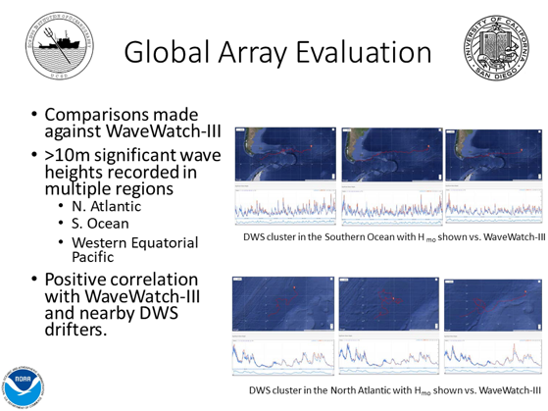
Evaluation of the
Directional Wave Spectra Drifter
Field Evaluations
Evaluation efforts began in 2015 and are on-going. Currently in latter stages of a multi-year process
Collaboration with the WMO and JCOMM sponsored Task Team on Wave Measurements via Data Buoy Cooperation Panel (DBCP) to ensure needs of the greater community are met and addressed
Co-located field campaigns with established wave sensors such as the Datawell DWR, Axys Triaxys, and bottom mounted ADCP have shown encouraging results
A full qualification of the GPS based sensor is required for every firmware revision. Sharing resources to facilitate sensor comparison can accelerate the qualification process
2015
2016
Despite GPS wave sensors becoming widely available, there are still few systematic and conclusive studies and evaluations on how accurately they can measure wave parameters
2017
2018
Clockwise from top left:
CDIP Scripps Nearshore Datawell DWR vs. LDL DWS Mooring
Port of Naples, Italy RD-Inst. ADCP vs. LDL DWS Mooring
Global Wave Watch III vs. LDL DWS Drifters
Queensland, Australia Datawell DWR vs. LDL DWS engine on DWR hull

Slide 6

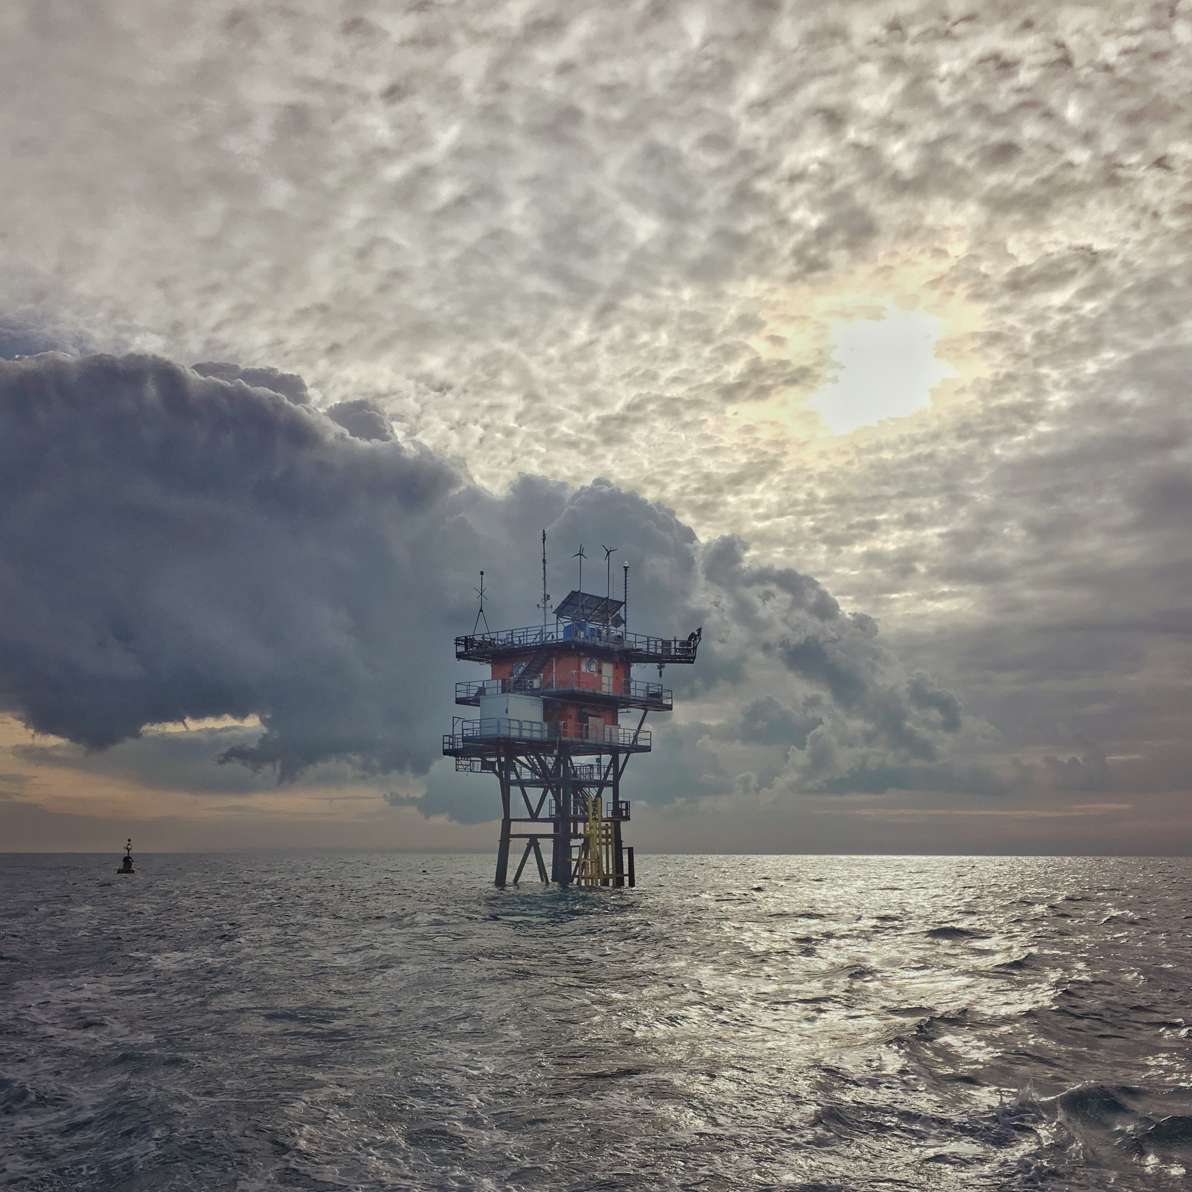
But…at a more fundamental level, what are we actually measuring?
Adriatic Sea Evaluation, Underway…
Inter-comparison underway with CNR-ISMAR
Utilize WAAS 3D camera system to track particle motion of moored DWS drifter
  Regardless of wave-engine used, is the DWS 0.4m hull sufficient for riding waves?
Wave Acquisition Stereo System (WAAS) installation on “Acqua Alta” platform in Venice, Italy

Slide 7
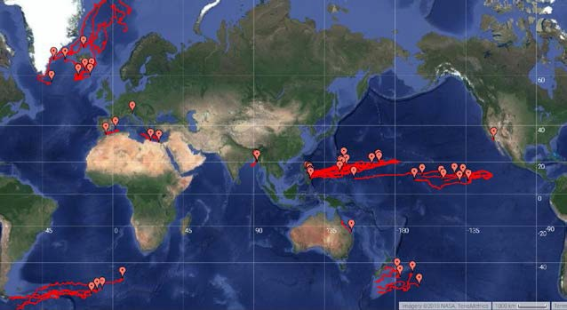
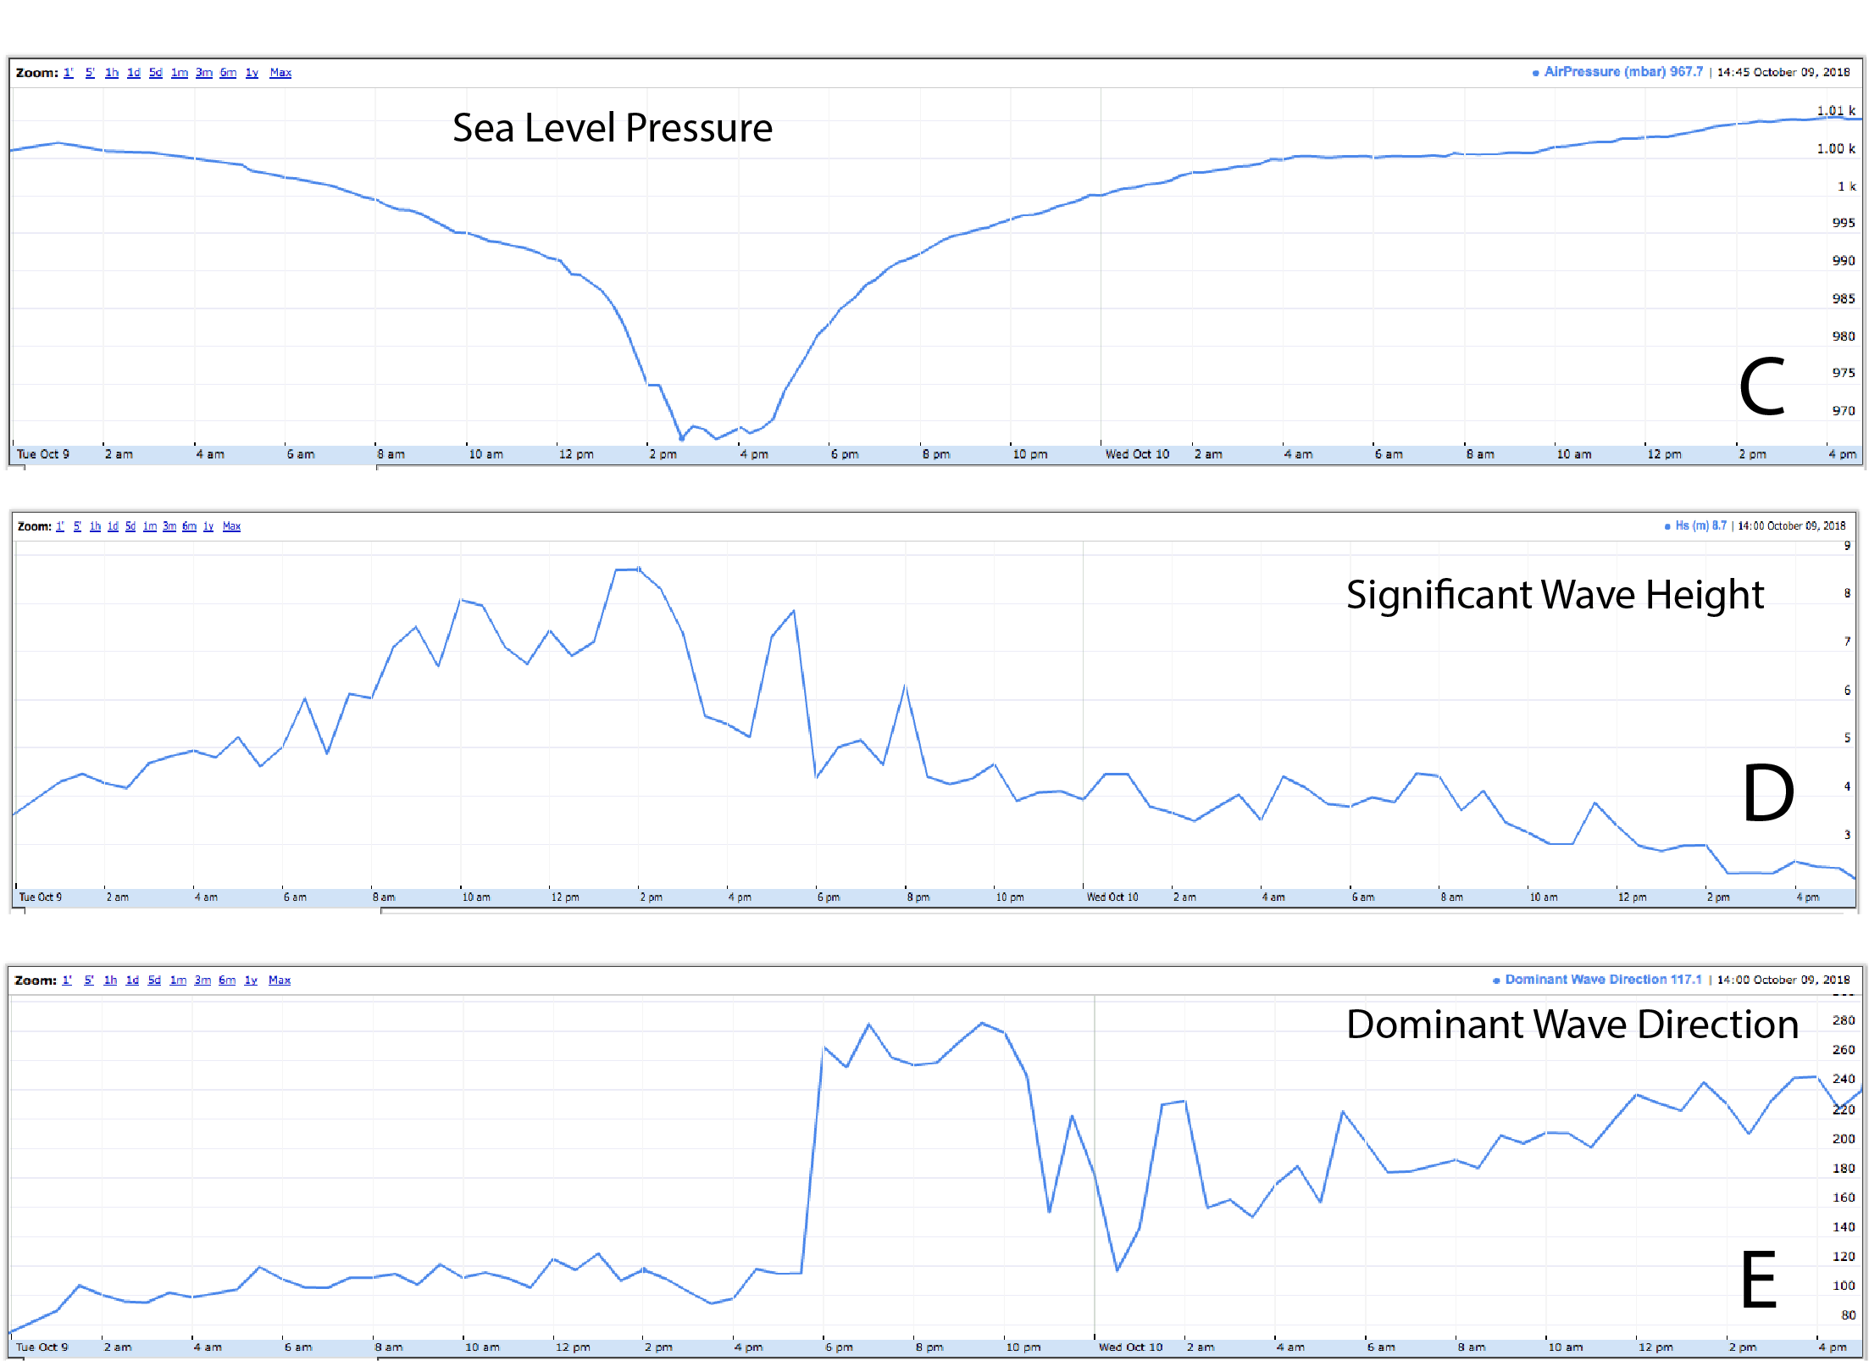
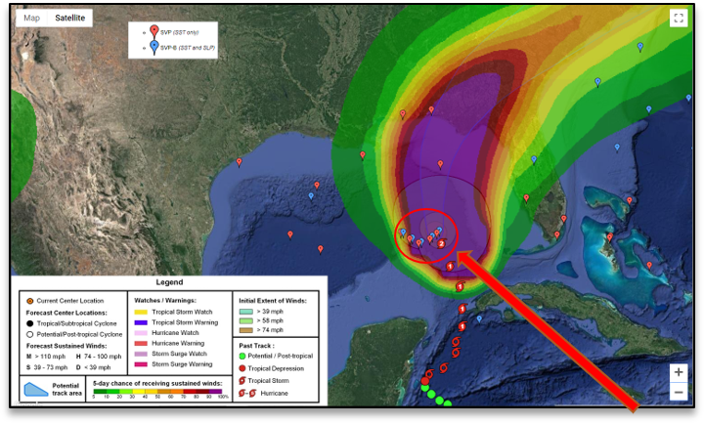
Examples of offshore deployments
Several deployment methods have been successfully used:
Research vessels, helicopter, aircraft, military ships
As with standard drifters, cargo and VOS deployment will present no issues
Top: Air deployment method. January 2019, Atmospheric River Drifter Deployment, NE Pacific Ocean
~9 m
Top: Global DWS drifter deployments
Bottom: Targeted air-deployment in front of Hurricane Michael
Left: Michael’s data
Link to Real-Time Data

Slide 8
Wave Observations: Southern Ocean
Maximum Significant Wave Height Recorded: 9.2 m on September 16, 2017, 23% smaller than WW3 (NCEP run)

Slide 9
What Does the State of the Art Support?
Coastal wave buoy networks, already in place
The combination of small (~40 cm diameter) and light (~10-15 kg) buoys with wave sensors based on GPS technology (e.g. the DWSD designed at SIO) appears to yield observations with an accuracy comparable to that of commercial wave riders that are considered a standard for in-situ wave measurements
The cost of a DWSD is about 50-100 times less than a Datawell MKIII wave rider, about 20-30 times less than that of a Datawell G4
Where do we go from here?
An Open Ocean Array of Wave Riders

Slide 10
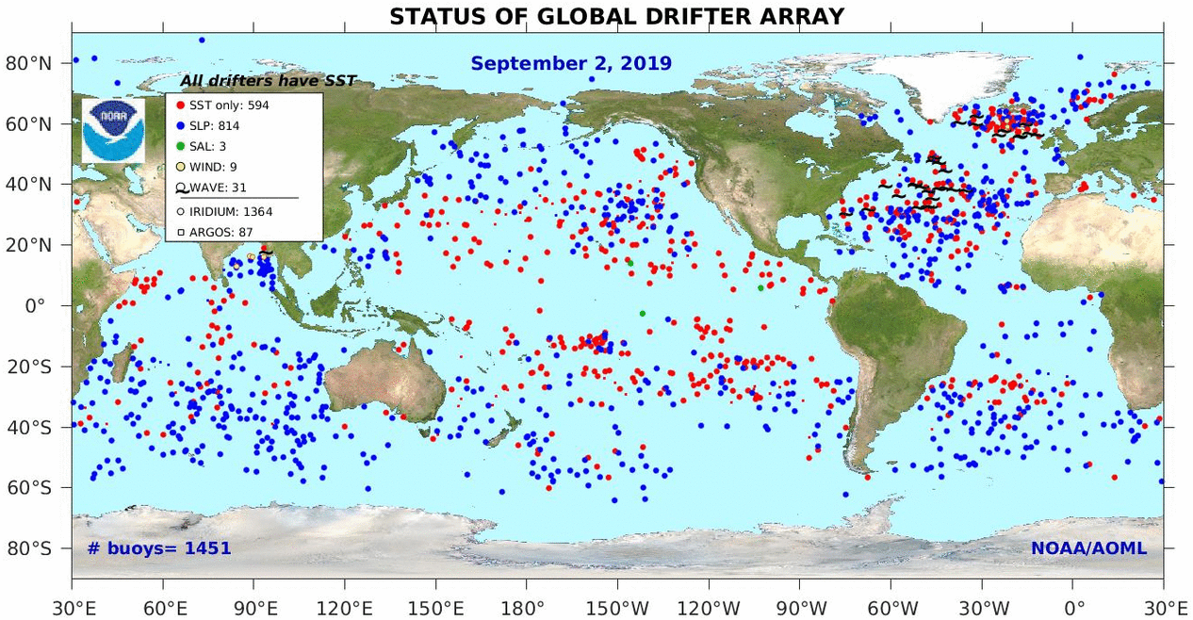
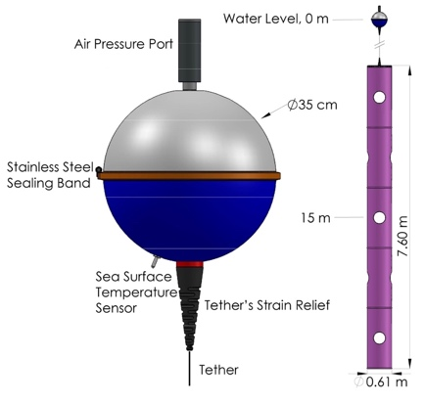
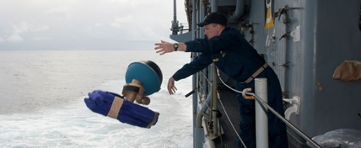
An Existing Example: the Global Drifter Program
The Only Global In-Situ Ocean Observing Network for Making Observations at the Air-Sea Interface
Overarching Goals:
Maintain a global 5ºx5º array of surface drifting buoys to meet the needs for an accurate and globally dense set of in-situ observations: mixed layer currents, SST, atmospheric pressure, winds, and salinity
Work with the international community to maintain the array
The GDP provides several observational baselines in the upper-ocean mixed-layer, and fills a unique role in the Global Climate Observing System. The positive impacts of the global and publicly available drifter data are large and well documented

Slide 11
Some Ideas for an Efficient/Quick Implementation of a Global Array
Array Design Domain: define common requirements (e.g. size of array and distribution with pilots and OSSE) for major applications such as;
Validation of modeled sea-state
Assimilation of directional spectra into forecasting models
Satellite Cal-Val
Historically, global oceanographic arrays have evolved by first adding the hardware and then (sometimes) demonstrating impacts in order to advocate their sustainability. In the present funding climate, and with multiple competing technologies, an effective approach requires careful design, active engagement of users/stakeholders and infrastructure cost saving considerations/optimizations
In Progress…
Hardware Domain: global deployment logistics and infrastructure
Done…
Data Distribution Domain: data distribution infrastructure, protocols and formats (e.g. GTS bulletins) ready;
Done…
Data Impact Domain: develop impact metrics and assessment tools in parallel with the evolving pilot array
In Progress…

Slide 12
DWSD & Global Wave Observations:
A Good Fit for the GDP
THE GDP/LDL R&D IS SCIENTIFICALLY DRIVEN AND TAILORED TO NOAA’S MISSION
Low environmental footprints (currently being addressed)
Published/well-defined standards
Baseline measurements in support of historical record
Open data access
THE DWS-D as an Evolving Sensor
Continuing Federally Funded R&D allow constant modernization and increased cost-effectiveness
Open Access Data Policy allows critical feedback from the user’s base
DWS-D BUILDS ON GDP INFRASTRUCTURE
Mature program (over 40yrs experience)
Minimum time to market/roll-out
Low overhead costs due to existing scientific and programmatic tasks
Shared technology with SVPB family means advancements from one will benefit all
DWSD data relay was designed around the LDL real-time data management system (GTS, AOML, Scientific partners)
A GLOBAL ARRAY OF WAVE SENSORS IS THE NATURAL EVOLUTION OF THE GDP, A UNIQUE INFRASTRACTURE STRATEGICALLY LOCATED AT THE AIR-SEA INTERFACE

Slide 13
How much would it cost? Would it be Sustainable?
Hint #1:
The DWSD has evolved from a sustainable, proven technology;
‘No-frills’ approach, meaning the DWSD is designed as an expendable instrument with small environmental footprint (post-consumer plastic, or renewable materials);
Marginal additional support required for the RT data relay infrastructure;
Incremental support required for increased logistic needs (storage, shipping)
What is the cost for a 5degX5 deg array?
Hint #2:
And the answer is…
~$2M/year
Is this sustainable?...
…Probably yes, it depends on the impacts

Slide 14
Impacts
Quantification of impacts need to proceed in parallel with the implementation of the wave array, to adjust the number and distribution of the sensors. This requires dedicated support but the payback consists of an optimally designed global network of wave sensors.
Aligned with GOOS 2030 Vision
Current: validation of numerical simulations has already proved to be of great interest, for example to NOAA’s National Weather Services/Ocean Prediction Center
Future: Assimilation of Directional Spectra still need work (at least at NOAA’s EMC). Once implemented, OSE studies designed to quantify the improvement (or error reduction) of wave forecasts can be run operationally
Others: Remote sensing, research (Physical Oceanography, TC intensification forecasting, Subseasonal to Seasonal predictions, Arctic ice forecasting) coast guard activities

Slide 15
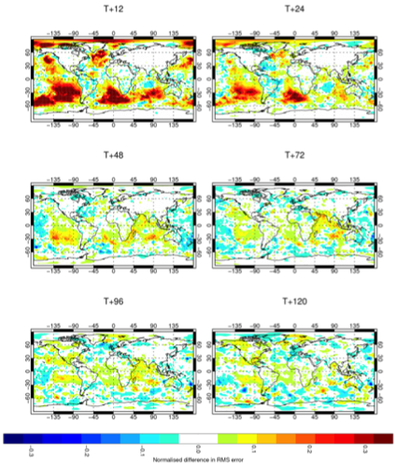
Sea Level Pressure (SLP) Impacts:
Weather, Altimetry, Climate Indices
Largest Source of global oceanic in-situ SLP
Drifters SLP data have the largest positive impact per observations. Both forecasting and climate studies benefit from drifter data, especially in the southern ocean where the drifters are essentially the only source of in-situ SLP data. See also Centurioni, et al (2016). Bulletin of the American Meteorological Society 98(2): 231-238
Inverse Barometer Effect, from SLP reanalysis, important for altimetry correction
Because of impacts, GDP/DBCP Barometer Upgrade Program, adds ~100 units/year
The barometer drifter array has several large impacts and it is implemented in collaboration with major international weather services
Normalised differences of mean sea level pressure root mean-squared errors between the control and denial experiment for . Red (blue)
colours indicate degradations (improvements) in the denial experiment. Forecast ranges: 12h, 24h, 48h, 72h, 96h and 120h.

Slide 16
Elements of Governance and Best Practices
Global Drifter Program Steering Committee (US-National)
The Data Buoy Cooperation Panel already has a Wave measurement Evaluation and Test (WET) Task Team. This body could be expanded to oversee the international coordination aspect
The global wave array will be part of GOOS (IOC) and WMO (JCOMM)
Best practices need to be created but many of GDP best practices could be adapted
No one wants more meetings and travel but shared governance cutting across different fields will ultimately result in rapid expansion and greater support

Slide 17
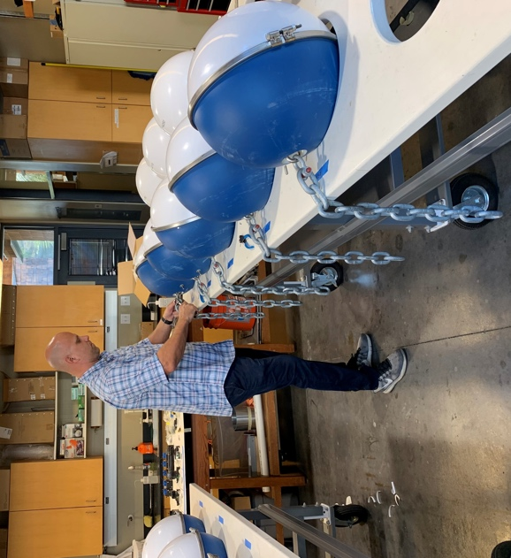
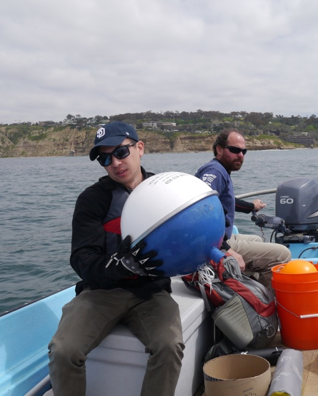
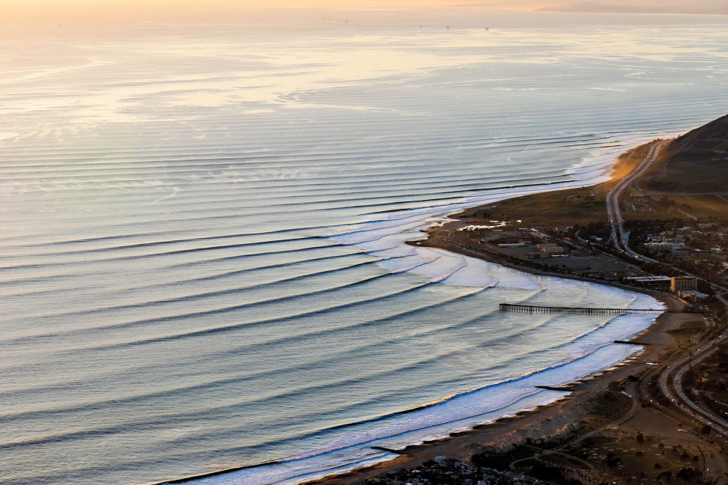
GDP-US roadmap for the Implementation of a Global Array of Wave sensors
(2019-2024)
Value for NOAA
Coordination with NOAA-NWS OPC (validation) and EMC (assimilation) has already been started. Importance of global wave observations (e.g. for subseasonal to seasonal forecasting) is anticipated for other NWS branches (i.e. CPC)
The design of the network suits NOAA’s needs for improving forecasting and advisory services (through e.g. validation and data ingestion into models as appropriate)
National Domain
Implement a national offshore network of DWSD around US areas of interest.
Global Domain
Expressions of Interest from : European Union, New Zealand, Australia (AIMS), China First Institute of Oceanography (FIO), Indonesia Met-Climate Service (BMKG), India’s Ministry of Earth Sciences (MoES), can be harvested under OAR/OOMD/GDP guidance and leadership into the first sustained global pilot
___________________________________________
Implement the two domains within the Framework For Ocean Observing
Adapt to new guidance that will emerge from Oceanobs ‘19
OVERARCHING GOAL
Implement and sustain a global array of DWSD

Slide 18
Take Home Messages
Drifters such as the DWSD can measure sea-state with an accuracy comparable to that of commercially available sensors, but at a much greater cost.
The technology can already support a sustainable global array, that we anticipate will have far reaching impacts
A quick implementation is possible within the GDP framework, and requires close synergy with users, a science driven design and implementation processes, and governance within the WMO/IOC framework

Slide 19
Vision Statement
“Implement and sustain a global DWSD array to fill the gap in offshore wave measurements to provide fundamental and unique directional wave observations. Such observations will be crucial to many activities, including validating wave forecasting models, better assessing the severity of seasonal and extreme storms (e.g., hurricanes) and for improving intraseasonal weather forecasting. They will also complement the existing wave climate dataset and will advance the science of physical oceanography. In-situ offshore directional wave observations will play a critical role in validating and calibrating upcoming satellite wave measurements and we anticipate that spectral wave measurements will soon be assimilated in operational wave forecasting models.
Centurioni, L. R., et al. (2019), Global in situ Observations of Essential Climate and Ocean Variables at the Air–Sea Interface, Frontiers in Marine Science, 6(419), doi:10.3389/fmars.2019.00419.

Slide 20
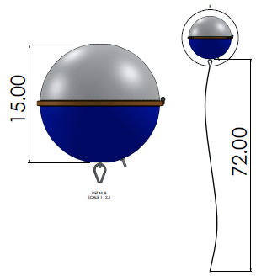
$
X1,000=
$
X2
$
X1,000=
$
X0.5

